Slide 1
Error Control: Stop and Wait ARQ

Slide 2
Definition
Stop and Wait ARQ (Automatic Repeat reQuest) is an error-control protocol where the sender transmits one frame at a time and waits for an acknowledgment (ACK) before sending the next frame.
It ensures reliable data transmission over noisy channels.

Slide 3
Working Procedure
Sender sends one frame.
Sender starts a timer.
Receiver checks for errors:
If correct → sends ACK.
If incorrect → sends NAK (or discards frame).
If ACK is received → sender sends next frame.
If ACK is not received before timeout → frame is retransmitted.

Slide 4
Flow Diagram (Simple)
Sender → Frame 0 → Receiver Receiver → ACK 0 → Sender Sender → Frame 1 → Receiver Receiver → ACK 1 → Sender
Only one frame is in transit at any time.

Slide 5
Types of Errors Handled
Lost Frame
Damaged Frame
Lost ACK
In all cases, timeout causes retransmission.

Slide 6
Difference Between Flow Control and Error Control
Basis of Comparison | Flow Control | Error Control
Definition | Technique to control the rate of data transmission between sender and receiver | Technique to detect and correct errors during data transmission
Main Objective | Prevent receiver overload | Ensure reliable and accurate data delivery
Problem Addressed | Speed mismatch between sender and receiver | Noise, data corruption, lost frames
Error Detection | Not concerned with errors | Uses CRC, Checksum, Parity, etc.
Mechanism Used | Stop-and-Wait, Sliding Window | Stop-and-Wait ARQ, Go-Back-N, Selective Repeat
Use of Timer | Usually not required | Required for timeout handling
Reliability | Controls flow only | Ensures correctness of data

Slide 7
Difference Between Stop-and-Wait Flow Control and Stop-and-Wait ARQ
Basis of Comparison | Stop-and-Wait Flow Control | Stop-and-Wait ARQ
Purpose | To control the rate of data transmission | To detect and correct transmission errors
Main Focus | Prevents receiver overflow | Ensures reliable data delivery
Error Detection | Not included | Included (CRC/Checksum)
Error Correction | Not provided | Provided through retransmission
Sequence Number | Not required | Uses 1-bit sequence number (0 and 1)
Timer | Generally not used | Used for timeout and retransmission
Retransmission | Not performed | Performed if frame/ACK is lost
Channel Assumption | Assumes error-free channel | Works in noisy channel

Slide 8
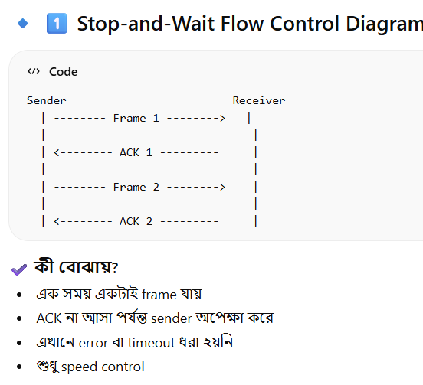
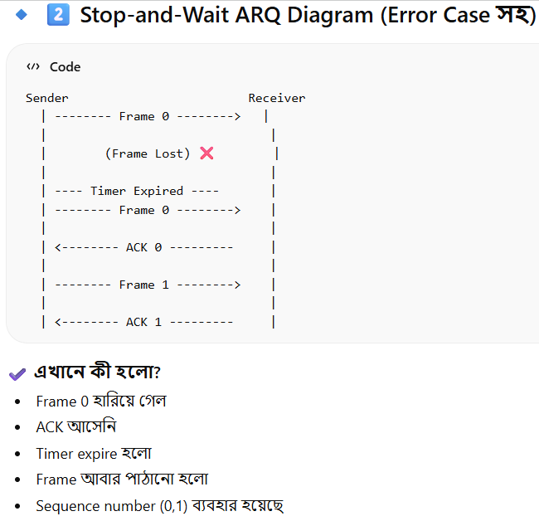

Slide 9
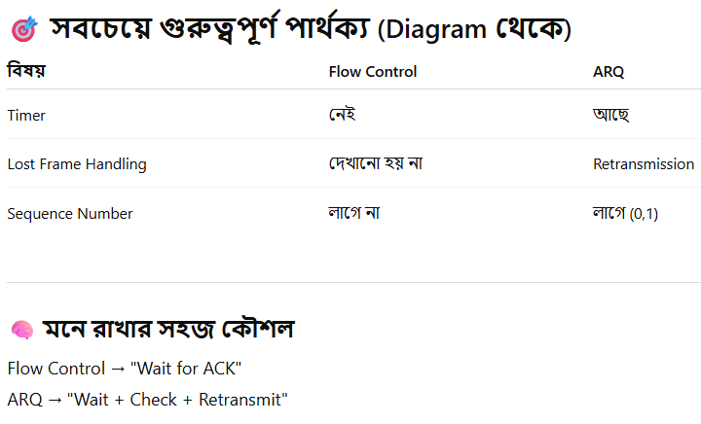

Slide 10
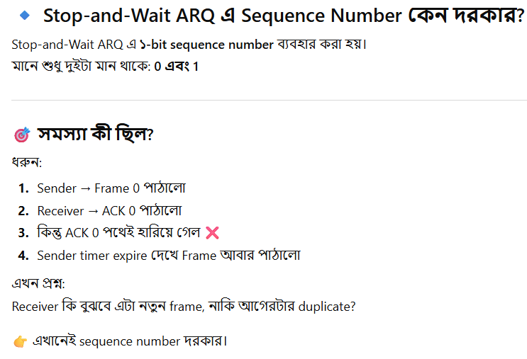

Slide 11
